Slide 1

Hotel Reservation Analysis
USING STRUCTURED QUERY LANGUAGE(SQL)

Slide 2
Contents of Presentation
Part 1
Introduction
Part 2
Data Loading and structure
Part 3
Analysis
Part 4
Conclusion

Slide 3

INTRODUCTION
The data is about a hotel reservation system with 700 total entries.
Data had the following variable:
Booking ID of the customers which is unique.
Number of adults and children in the reservation.
Number of nights that falls on week and weekend nights.
The meal plan chosen and room reserved by the guests.
Number of days between booking and arrival time and arrival date.
Average price per room.
Status of the booking.

Slide 4

Data Loading & Structure
The data was in the excel file so to analyze, it was loaded in MySQL Workbench. For this purpose, first a database was created with the name of Hotel_reservation. Then a table was created to load the data into the table with the name of Hotel_data. Data is loaded with table data import wizard load by right clicking on the Database option in the schemas.

Slide 5


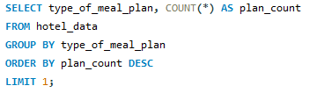

ANALYSIS
All the analysis is done on SQL. So, the first thing is to find out the total number of reservations. The query used and the result is s follows:
Moving forward, we'll see that which meal plan was most popular among the guest:
Meal plan 1 is most popular as it has highest count

Slide 6





ANALYSIS
To check the average price per room involving children,
Now for checking the total number of reservations made for the year 2017 & 2018

Slide 7
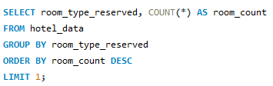


ANALYSIS
It is also important to understand that which room type is the most common for reservations
Room type 1 is most commonly reserved room.
Now the number of reservations that fall on weekend is

Slide 8

ANALYSIS
The next thing to check is what is the highest and lowest time for reservation

Slide 9


ANALYSIS
The most common market segment for the reservation and the reservations that are confirmed are as follows:
The number of confirmed reservation

Slide 10
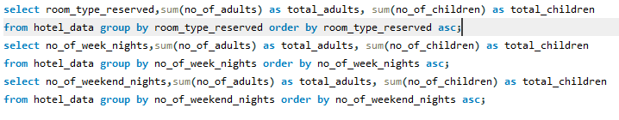
ANALYSIS
The total number of adults and children across all reservations are given below:
The results are on the next slide….

Slide 11
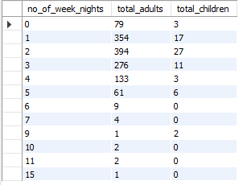
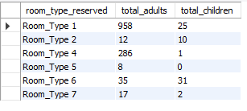
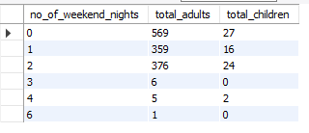
According to week night reservation
According to room type reserved
According to weekend night reservation

Slide 12

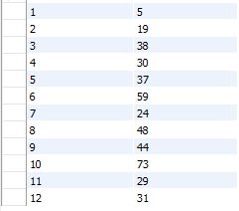
ANALYSIS
The average number of weekend night for reservation involving children.
The total reservations made on each month of the year

Slide 13
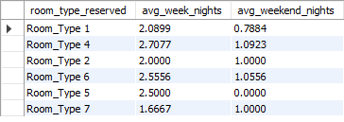
ANALYSIS
Average number of nights spent by guest for each room type

Slide 14


ANALYSIS
For reservations involving children, the most common room type, and the average price for that room type is
The market segment type that generates the highest average price per room.

Slide 15

CONCLUSION
In conclusion, hotel reservation analysis, implemented with the help of SQL, has demonstrated the significant key points. System’s key function, such as real-time availability data management, and detailed reporting, not only enhances the user experience but also provide valuable insights for operational decision making. The implementation of SQL queries for various operation ranging from booking cancellation to data analytics has allowed to maintain data integrity and optimize overall work flow.

